Slide 1
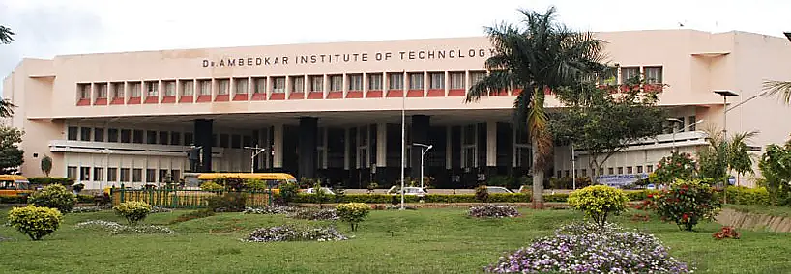

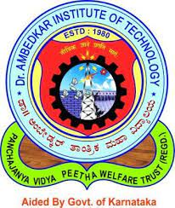
Mini Project Review - I
“ ARDUINO BASED ALCOHOL DETECTION AND ENGINE LOCKING SYSTEM ”
Under the Guidance of
MANJULA
ASSISTANT PROFESSOR
Submitted by
JEEVAN GN 1DA20EC054
KARAN R GOWDA 1DA20EC059
MADHU KM 1DA20EC071
MANOHAR R 1DA20EC076

Slide 2
Contents
Introduction
Objectives
Literature Survey
Methodology
Design Requirements
Applications
Advantages
References

Slide 3
Introduction
The current scenario shows that the most of the road accidents are occurring due to drunk-driving.
The drivers who drink alcohol are not in an stable condition and so, rash driving occurs on highway which can be risky to the lives of the people on road, the driver inclusive.
The enormity of the dangerous driving transcends boundary. The laws in India are currently prohibiting drivers to drink and drive so that the fine can stop them to drink and drive.
Whatever, effective observation of inebriated drivers could be a challenge to the policemen and road safety officers, the rationale for this stems from the natural inability of citizenry to be present additionally as state among identical house and time. There is therefore the need for an alcohol detection system that can function without the restriction of space and time.

Slide 4
The Indian Ministry of Statistics reported thousands of road accidents in 2016. Though the report declared speed violation is the foremost reason for these accidents, it will safely be inferred that almost all of the cases are because of driver’s unstable condition caused by drivers becoming drunk before they drive.
The investigation done by the Planet Health Organization in 2008 shows that concerning 50%-60% of traffic accidents square measure associated with drink-driving
This shows that almost all drivers, particularly business and serious duty trucks drivers interact in drink driving, which may result in accident. Bharat sets a legal limit of 30mg/100mL blood alcohol concentration (BAC), any level higher than that's same to be ineligible.
. BAC level of 0.2 to 0.3 continues to be not safe however the motive force still. So, there is need of such system which can reduce the number of road accidents caused due to drunk driving

Slide 5
Objectives
Accident prevention: Reduce accidents caused by drunk driving by disabling the engine when alcohol is detected.
Deterrence: Discourage intoxicated individuals from driving by implementing a system that restricts vehicle operation.
Enhance road safety: Protect impaired drivers, other road users, pedestrians, and passengers from the risks of alcohol-impaired driving.
Compliance: Ensure adherence to laws and regulations regarding alcohol-impaired driving.

Slide 6
Public awareness and education: Raise awareness about the dangers of drunk driving and promote responsible decision-making.
Technological innovation: Explore advancements in alcohol detection sensors, vehicle integration, data processing, and communication protocols.
Law enforcement integration: Collaborate with law enforcement to facilitate identification and apprehension of drunk drivers.
The main focus of the project is to prevent accidents, promote responsible behavior, and enhance overall road safety.

Slide 7
Literature Review
Title | Author | Journal with published year | Outcomes
Automatic Engine Locking System Through Alcohol Detection | Dr. Pavan Shukla1 ,Utkarsh Srivastava2 | International Journal of Engineering Research & Technology (IJERT)ISSN: 2278-0181 05, May-2020 | The proposed system include alcohol detection sensors that can measure the alcohol content in the driver's breath or bloodstream.
Alcohol Detection and Engine Locking System | Dr. Nookala, Venu and M, Vamshi and V, Akhil and K, Deepika and K, Prashanth and M, Raffiudhin | Innovative Engineering and Management Research (IJIEMR) 2022 | The paper explained With GPS, the system can track the vehicle's location in real-time
Review Paper On Alcohol Detection And Vehicle Engine Locking System | Dr. K. Ravi Kumar , Yellapu Neeraj Kumar , Midathana Kisran , Urikiti Teja , MD Shakeer | 2022-12-31 — Updated on 2022-12-31 | The article could describe the technical details of integrating the alcohol detection system with the vehicle's engine control unit

Slide 8
Methodology
Alcohol Concentration Measurement: The project commenced with the careful selection and integration of a suitable alcohol sensor into the system architecture, allowing for precise measurement of alcohol concentration in the air. This sensor provided analog output voltage, which was effectively interfaced with the Arduino Uno.
Real-time Monitoring and Alert Generation: The system's programming logic was meticulously designed to ensure continuous monitoring of the alcohol concentration. By continuously reading the analog value from the alcohol sensor, the Arduino was able to convert this data into real-time alcohol concentration measurements.
Data Display and User Interface: To facilitate a user-friendly experience, a 16x2 LCD screen was seamlessly integrated into the system's interface. The LCD screen provided a clear and easily interpretable user interface by displaying real-time alcohol concentration measurements, the system's status (e.g., alert or normal), and user instructions

Slide 9
Methodology
LED Indication and User Control: Visual feedback was incorporated into the system's design through the integration of an LED indicator. This LED played a crucial role in communicating the alcohol concentration status to the driver.
If the reading is greater than the threshold level, ARDUINO will stop the DC motor. The red LED will also blink if the distance is less than the safe distance to give indication to other vehicles that the vehicle in front of them is unsafe.
Automation and Safety: To enforce the system's safety mechanism, a relay module was employed to control the power supply to the vehicle's engine components. The Arduino's digital output pin was utilized to manage the relay effectively. When the alcohol concentration exceeded the defined threshold, the system activated the relay, effectively preventing the engine from starting.

Slide 10
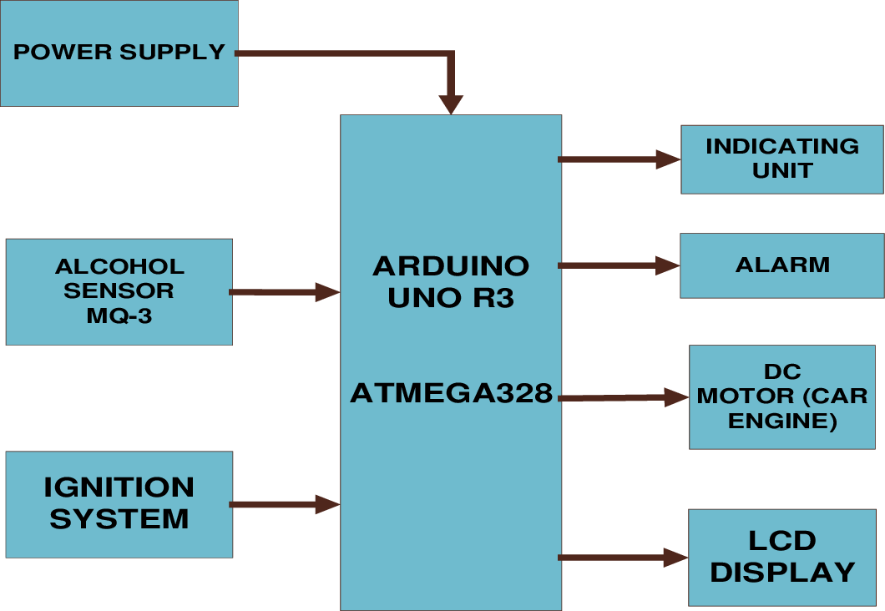
BLOCK DIAGRAM:

Slide 11
Components required :
Component | Quantity
ARDUINO UNO | 1
Red Led(INDICATION UNIT) | 1
MQ-3 Alcohol sensor | 1
A RELAY | 1
DC motor | 1
A buzzer | 1

Slide 12
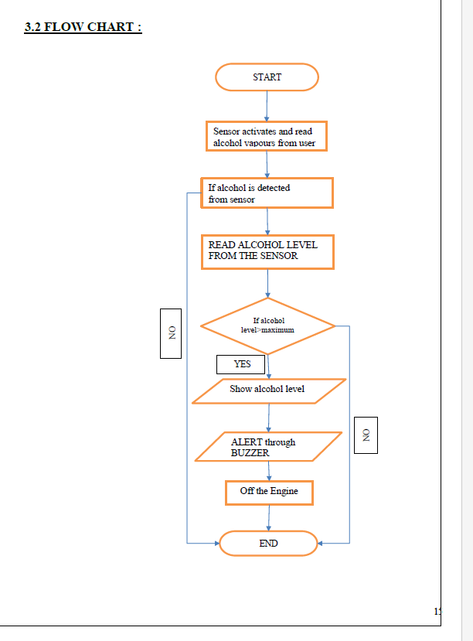
FLOW CHART:

Slide 13

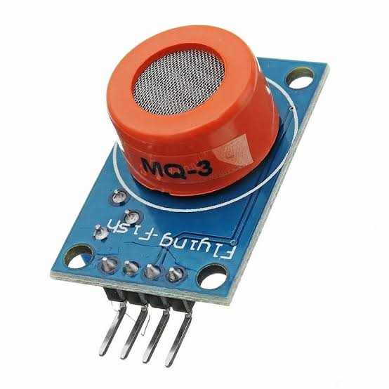
Design Requirements and Specifications
1.) MQ-3 Alcohol sensor
1.Concentration: MQ-3 alcohol sensor provides analog voltage output based on alcohol vapor concentration
2.Voltage: Operates at 5V DC for easy integration with electronic circuits.
3.Load Resistance:Recommended 2K ohms load resistance for optimal performance.
4.Accuracy:Offers indication of alcohol presence, but not precise concentration measurements.
5. Range: Detects alcohol vapors in the air within 0 to 1000 ppm range.
6.Response Time: Swift response in a few seconds to changes in alcohol concentration.
Department of Electronics and Communication Engineering, Dr. AIT
10

Slide 14
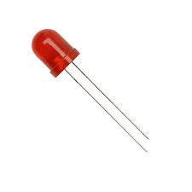
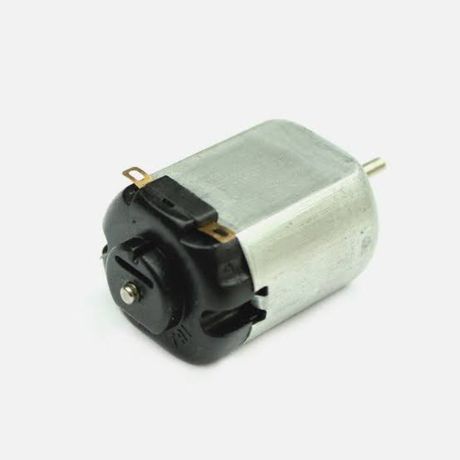
2. LED (5mm)
Design Requirements and Specifications(contd….)
3. DC MOTOR
Size: 5mm in diameter Forward voltage: 1.8-2.4V Current: 10-20mA
Colour: Red
Operating temperature: -20 to 85 °C
Type: Brushed DC motor
Voltage: 5V DC power supply.
Speed: 3270in RPM
Torque: 0.057 the torque in Nm
Efficiency: 67% efficiency
Department of Electronics and Communication Engineering, Dr. AIT
11

Slide 15
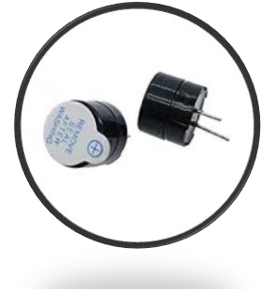
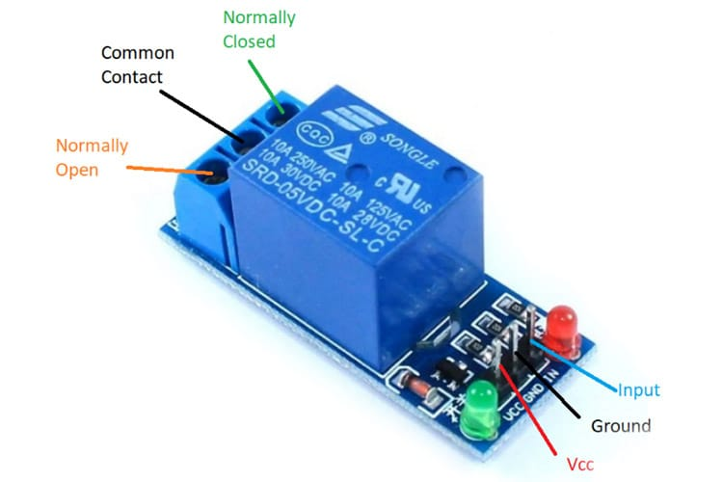
4.A Relay
Design Requirements and Specifications(contd….)
5. Buzzer
Normal voltage: 5V DC.
Normal current: 70mA.
Maximum load current: 10A/250V AC, 10A/30V DC.
Contact resistance: 25mΩ
Insulation resistance: 100MΩ
Transducer Function: Buzzer Supply Voltage Min: 1.5V Supply Voltage Max: 16V Operating Current Max: 8m Sound Level: 85dB
Resonant Frequency: 4.3kHz
Department of Electronics and Communication Engineering, Dr. AIT
12

Slide 16
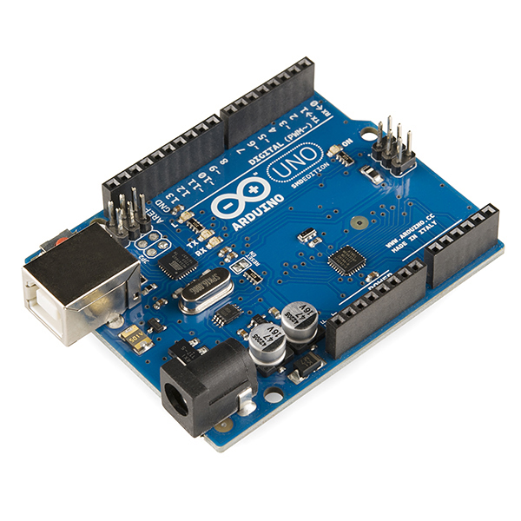
Design Requirements and Specifications(contd….)
6.Arduino Uno
Microcontroller: ATmega328P
Operating voltage: 5V Input voltage: 7-12V
Flash memory: 32KB SRAM: 2KB EEPROM: 1KB
Digital I/O pins: 14 (6 of which can be used as PWM outputs) Analog inputs: 8
Clock speed: 16 MHz
Department of Electronics and Communication Engineering, Dr. AIT
13

Slide 17
IMPLEMENTATION:

Slide 18
Applications:
Road Safety: The primary application of this project is to enhance road safety by preventing drunk driving. According to statistics, a significant percentage of road accidents are caused by drivers under the influence of alcohol. Implementing alcohol detection and engine control systems can help reduce the number of accidents and save lives.
Public Transport Vehicles: Public transport operators can utilize the system to ensure that drivers are not operating vehicles under the influence of alcohol. This safeguarding measure prioritizes the well-being of passengers, offering peace of mind to those using public transportation services.
Law Enforcement: This technology can assist law enforcement agencies in enforcing drunk driving laws more effectively. It acts as a proactive measure to prevent drunk drivers from getting on the road, thus reducing the need for reactive measures like DUI checkpoints and subsequent arrests.

Slide 19
4. Commercial Fleets: The project can be applied to commercial fleets, such as taxis, buses, and delivery vehicles, to ensure that drivers are not under the influence of alcohol while on duty. This can protect passengers and other road users and safeguard the reputation of the company.
5. Personal Vehicles: The technology can also be integrated into personal vehicles, especially for those who have a history of alcohol-related incidents or for parents who want to monitor and control their children's driving behavior.
6. Preventing Drunk Driving Incidents: One of its primary functions is to lock the engine when alcohol concentration surpasses the predefined threshold. This proactive measure eliminates the possibility of starting the vehicle under the influence of alcohol, effectively mitigating accidents and fatalities associated with alcohol-impaired driving.

Slide 20
Advantages:
Preventing Accidents: The most significant advantage of this project is its potential to prevent accidents caused by drunk driving. By restricting the vehicle's operation when alcohol is detected, it can reduce the chances of accidents and their associated injuries and fatalities.
Saving Lives: Implementation of alcohol detection and engine control systems can potentially save lives by keeping impaired drivers off the road, thereby avoiding potential collisions.
Legal Compliance: For commercial fleets, this technology helps companies comply with regulations and reduce liabilities related to accidents caused by their drivers.
Deterrent Effect: Knowing that their vehicles have an alcohol detection system in place, drivers may be less likely to attempt driving under the influence of alcohol, leading to a deterrent effect.

Slide 21
5. Reduced Insurance Costs: As accidents caused by drunk driving decrease, insurance companies may offer lower premiums to vehicle owners with this safety feature, incentivizing its adoption.
6. Personalized Monitoring: For personal vehicles, parents and guardians can have peace of mind knowing they can monitor their young drivers' behavior and ensure they are not driving under the influence.
It's important to note that while the project has numerous advantages, it is not a substitute for responsible driving habits, public awareness campaigns, and the promotion of alternative transportation options for individuals who have consumed alcohol. Additionally, care should be taken to avoid false positives and ensure that the system is accurate and reliable.

Slide 22
RESULTS:
The project "Alcohol Detection and Engine Locking System" yielded significant results. The integration of the MQ-3 alcohol sensor seamlessly provided accurate alcohol concentration measurements, which were then converted into understandable values. An effective alert system with LED indicators and LCD displays ensured timely notifications. The inclusion of a manual override button offered flexibility for drivers while maintaining safety. The engine locking mechanism, controlled by a relay, reliably prevented engine startup when alcohol concentration surpassed the threshold. An efficient LiPo battery served as a reliable power source. Beyond testing, the system's real-world applicability was evident, positioning it as a valuable tool in combating drunk driving and promoting road safety.

Slide 23
References
[1] L. A. Navarro, M. A. Diño, E. Joson, R. Anacan and R. D. Cruz, "Design of Alcohol Detection System for Car Users thru Iris Recognition Pattern Using Wavelet Transform," 2016 7th International Conference on Intelligent Systems, Modelling and Simulation (ISMS), Bangkok, 2016, pp. 15-19.
[2] MUGILA.G, MUTHULAKSHMI.M, SANTHIYA.K, Prof. DHIVYA. P- SMART HELMET SYSTEM USING ALCOHOLDETECTION FOR VEHICLE PROTECTION[International Journal of Innovative Research in Science Engineering and Technology(IJIRTSE) ISSN: 2395-5619, Volume – 2, Issue – 7. July 2016]
[3] Dhivya M and Kathiravan S, Dept. of ECE, Kalaignar Karunanidhi Institute of Technology- Driver Authentication and Accident Avoidance System for Vehicles [Smart Computing Review, vol. 5, no.1, February 2015].

